Slide 1
Counting sort
aka pigeonhole sort
Diff. problem: n students take a quiz, score from 1 to 10. List of scores:7,2,5,…
Want to know: # 1’s , # 2’s …Solution?
How to use idea for sorting?: first look at simpler version
Stable Sorting: relative order of equal elements does not change
Notes:
CS 632/CS 326 Algorithms
Fall 13, Week 2
7

Slide 2
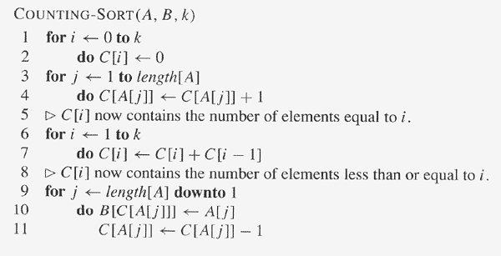
Counting sort
Notes:
CS 632/CS 326 Algorithms
Fall 13, Week 2
7

Slide 3
Preprocessing
Willing to spend some time upfront to transform data to save time later. Eg ?
Eg: sorting. To save time for what ?
Searching – binary search faster, can only be done on a sorted array
Eg: Counting sort
  Creating the array C[ ]
Notes:
CS 632/CS 326 Algorithms
Fall 13, Week 2
7

Slide 4
Problem time bounds
Avg case, worst case always same ?
No – quick sort
Problem time bounds: time bound for a problem independent of algorithm.
Sort faster than O(n²)?
Yes – merge sort.
Sort faster than O(n log n)?
No i.e. no comparison-based algorithm can sorter faster.
Notes:
CS 632/CS 326 Algorithms
Fall 13, Week 2
7

Slide 5
Lower bounds for sorting
Comparison based sort:
numbers are black boxes.
  7, 9,5,12 same as
  500, 800,2,10000
Decision tree: model of computation.
Lower bd for searching:
Lower bd for sorting:
Do these apply to counting sort?
No : is not comparison-based
Notes:
CS 632/CS 326 Algorithms
Fall 13, Week 2
7

Slide 6
Review of data structures
Linked list: singly linked, doubly linked, circular
Stack: LIFO, push, pop, program stacks.
Queue: FIFO, enqueue, dequeue.
Tree: parent, child, root, descendent, ancestor, sibling, height, depth, path, full, complete.
Binary Tree: Lchild, Rchild
Notes:
CS 632/CS 326 Algorithms
Fall 13, Week 2
7

Slide 7
Review of data structures
Binary Search Tree:
  L <= parent <= R
  Useful for searching. How much time?
depends on height. How much is height ?
O(n) in worst case – Eg ?
Want a small height tree. Complete tree?
No – need flexibility for insertions/deletions
  While guaranteeing small height. What works ?
Balanced Binary Search Tree?
  AVL, Red-Black.
Notes:
CS 632/CS 326 Algorithms
Fall 13, Week 2
7

Slide 8
Review: Priority Queues
What do we want: Given elements with keys, order amongst keys, want to carry out the following operations on Q:
  Insert (x,Q)
  ExtractMax(Q)
  Maximum(Q)
Eg: prioritized jobs on a computer

Slide 9
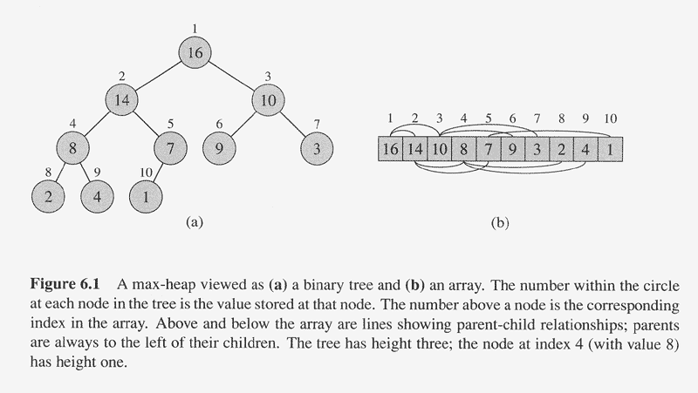
Heaps
Structural Property: Complete binary tree
Heap Property (Max-Heap): parent >= child
Eg [CLR Fig 6.1]
Notes:
CS 632/CS 326 Algorithms
Fall 13, Week 2
7

Slide 10
Heaps
Insert: How to do ?
Insert at bottom right (after rightmost elt in bottom row)
  reheapify by moving up
ExtractMax: How to do ?
Exchange with bottom right (rightmost elt in bottom row)
  reheapify by moving down
Not a search tree !
Notes:
CS 632/CS 326 Algorithms
Fall 13, Week 2
7

Slide 11
Heap time analysis
Height of tree ?
O (log n)
Time for Insert ?
O (log n)
Time for ExtractMax ?
O (log n)
Notes:
CS 632/CS 326 Algorithms
Fall 13, Week 2
7

Slide 12
Heap implementations [Fig 6.1]
Notes:
CS 632/CS 326 Algorithms
Fall 13, Week 2
7

Slide 13
Heap implementations
How to implement a heap?
Can do as a binary tree using pointers in the usual way.
Can also implement with arrays.
  Lchild(i) = 2i
  Rchild(i) = 2i + 1
  Parent(i) = ⎣i/2⎦
Notes:
CS 632/CS 326 Algorithms
Fall 13, Week 2
7

Slide 14
Heap sort
MinHeap: parent < child
Heap Sort:
for i from 1 to n
Insert(A[i],Q)
for i from 1 to n
A[i] = ExtractMin(Q)
Time ?
O(n log n)
Can build heap faster: in time O(n), bottom up
  Will change time analysis of heap sort ?
Notes:
CS 632/CS 326 Algorithms
Fall 13, Week 2
7

Slide 15
More Math Preliminaries:
Permutations and Combinations
  order matters. Permutation: Yes. Combination: No.
  Permutations Eg: # 2 letter words can you make with 3 letters a,b,c.
Permutations : nPk (or ^{n}P_{k} ): number of ways of arranging k out of n items
  nPk = ?
nPk = n!/(n-k)!
Notes:
CS 632/CS 326 Algorithms
Fall 13, Week 2
7

Slide 16
More Math Preliminaries:
  Combinations Eg: #2 member committees can you make with 3 people x,y,z.
Combinations : nCk (or ^{n}C_{k} ): number of ways of picking k out of n items
  order does not matter.
  nCk = ?
nCk = n!/k!(n-k)!
Notes:
CS 632/CS 326 Algorithms
Fall 13, Week 2
7

Slide 17
More Math Preliminaries:
Proof by induction : sum of first n numbers.
Prime number : divisible only by 1 and itself : 2,3,5,7…
  can’t be written as product of other numbers
  eg. 2,3,5,7, 11, 13 are prime, 4,6,8,9,10 are not
  4,6,8,9,10 are composite numbers
Proof by contradiction : no largest prime.
Notes:
CS 632/CS 326 Algorithms
Fall 13, Week 2
7

